Slide 1
gTLD Statistics & Business Implications
2015 – 1st Quarter Review

Slide 2
Overview
2014 Recap
Circa pre-2012 & 2012 gTLD statistics
2015 1st Quarter
Circa pre-2012 & 2012 gTLD statistics
Post - 2012 gTLD Tiers Business Implications
Volumes & Values new gTLDs can expect
Correlation between Prices, Volumes, etc.
Impact on registry financials
Business models considerations – additional value adds/value proposition over registrations

Slide 3
gTLD Circas
Why the need for a label change?
gTLDs delegated before the 2012 “New gTLD” round are often referred to as legacy or traditional gTLDs and many do not prefer the label of “legacy”.
gTLDs delegated from the 2012 “New gTLD Program” round are not really new any more.
What is a Circa as it pertains to gTLDs?
Pre-2012 Circa include gTLDs like .com, .net, .org, .biz, .mobi, etc.
2012 Circa are new gTLDs from the applications for the 2012 and delegated in 2013 to present.
Future application rounds can be easily referred to using Circas by Year rather than new and old gTLDs.

Slide 4
2014 Recap

Slide 5
2014 – Circa Pre-2012 gTLD Stats
.com
Group 1
Group 2
Group 3
Jan - 111,843,404
Dec - 115,312,494
+3.0%
Source: TLDWatch Zone collection
Note: .CAT is missing given zonefile format
Notes:
biz info mobi net org ***zonefile data only, does not incl. dark domains
-10.9% -6.7% -45.2% -1.0% 1.0%
asia name pro tel xxx
-39.8% -9.6% -6.4% -60.7% -7.6%
aero coop jobs museum name post pro travel
1.7% 3.5% 2.3% 2.5% -9.6% 43.2% -6.4% -4.1%

Slide 6
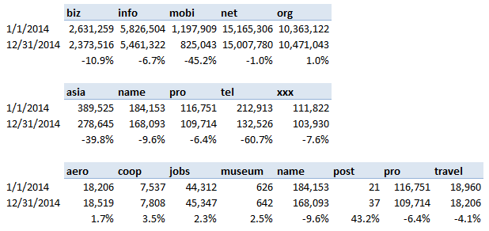
2014 – Circa Pre-2012 gTLD Stats
.com
Group 1
Group 2
Group 3
Jan - 111,843,404
Dec - 115,312,494
+3.1%
Source: TLDWatch Zone collection
Notes:
biz info mobi net org ***zonefile data only, does not incl. dark domains
-10.9% -6.7% -45.2% -1.0% 1.0%
asia name pro tel xxx
-39.8% -9.6% -6.4% -60.7% -7.6%
aero coop jobs museum name post pro travel
1.7% 3.5% 2.3% 2.5% -9.6% 43.2% -6.4% -4.1%

Slide 7
2014 – Circa Pre-2012 gTLD Stats
Source: Dec 2014 Ry Reports & TLDWatch Zone collection
Note: This reporting function will expand for future reports; Ry reports to ICANN are not revealed until 3 months after posting
Notes:
POST (3)
MUSEUM (187)
COOP 253
TRAVEL 858
AERO (9009)
JOBS 172
XXX (2150)
PRO 16778
TEL (2378)
NAME 22758
ASIA 41307
MOBI 46175
BIZ 95934
INFO (70118)
ORG 25756
NET 501425
COM 3702429
http://domainincite.com/18213-verisign-adds-750000-com-names-instantly-with-reporting-change

Slide 8
2014 – Circa Pre-2012, Top 10 Registrars
Source: Dec 2014 Ry Reports

Slide 9
2014 – Circa 2012 gTLD Stats
No 2014 GA Launch Data:
46 - Brand
40 - Generic
06 - Geo
Ry Reports Submitted to ICANN not processed yet
Source: TLDWatch Zone collection
Notes:
448 Delegated
280 GA
92 no 2014 launch info

Slide 10
2014 – Circa 2012 Top 20 gTLDs
Source: TLDWatch Zone collection

Slide 11
2014 – Circa 2012 gTLD Applications
Application View – 1930 Total
Unique String View - 1408
*Applied = yet to be settled
**471 Delegated as 4 Jan per ICANN
***162 applications in contention
*87 unique strings in Contention (includes .corp, .home, .mail)
as of 31 Dec 2014

Slide 12
2015 1st Quarter

Slide 13
2015 Q1 - Circa Pre-2012 gTLD Stats
Group 1
Group 2
Group 3
.com
Jan - 115,312,494
Mar – 116,933,917
+1.3%
Source: TLDWatch Zone collection

Slide 14
2015 Q1 – Circa 2012 gTLD Stats
581 - Delegated
370 - General Availability
No 2015 GA Launch Data:
38 - Brand
21 - Generic
02 - Geo
Source: TLDWatch Zone collection
Notes:
581 Delegated
61 no 2015 launch info

Slide 15
2015 Q1 – Circa 2012 Top 20 gTLDs
Source: TLDWatch Zone collection

Slide 16
2015 Q1 – Circa 2012 gTLD Applications
Application View - 1930
Unique String View - 1408
Applied = yet to be settled
890 RyA signed
581 Delegated as 31 Mar per ICANN (+110 from 31 Dec 2014)
145 applications in contention (102, ineligible)
42 unique strings in Contention
as of 31 Mar 2015

Slide 17
2015 Q1 – Auction Results & Schedule
Contentions Settled to Date:
212 strings resolved across 631 applicants
13 strings via ICANN Auction for $61.9 Million
**Update – 29 Apr & 27 May Sets Now Resolved
ICANN Settled Auctions:
4/29/2015
.fun - 3
.living - 2
.map - 3
.search - 4
5/20/2015
game - 5
games - 1
5/27/2015
stream - 2
String | Auction Date | Winning Applicant | Winning Price
PING | 25-Mar-15 | Ping Registry Provider, Inc.* | $1,501,000
SRL | 25-Mar-15 | mySRL GmbH | $400,000
APP | 25-Feb-15 | Charleston Road Registry Inc. | $25,001,000
BABY | 17-Dec-14 | Johnson & Johnson Services, Inc. | $3,088,888
MLS | 17-Dec-14 | The Canadian Real Estate Association | $3,359,000
DOT | 19-Nov-14 | Dish DBS Corporation | $700,000
REALTY | 22-Oct-14 | Fegistry, LLC | $5,588,888
SALON | 22-Oct-14 | Outer Orchard, LLC | $5,100,575
SPOT | 22-Oct-14 | Amazon EU S.à r.l. | $2,200,000
BUY | 17-Sep-14 | Amazon EU S.à r.l. | $4,588,888
TECH | 17-Sep-14 | Dot Tech LLC | $6,760,000
VIP | 17-Sep-14 | Minds + Machines Group Limited | $3,000,888
信息 (xn--vuq861b) | 4-Jun-14 | Beijing Tele-info Network Technology Co., Ltd. | $600,000
Source: icann.org as processed through TLDWatch
*Auction schedule subject to change

Slide 18
2015 Q1 – Circa 2012 Top 12 Ry Operators
Registry Operators represented here are based on the parent organization and not necessarily the company that signed the Registry Agreement.
These figures are based on gTLDs processed from the 2012 application round and that are now delegated in the rootzone and processed in TLDWatch systems.
Source: as registered through TLDWatch

Slide 19
2015 Q1 – Circa 2012 Top 10 RSP
Registry Service Providers provide the backend systems support for Registry Operators.
These figures are based on gTLDs processed from the 2012 application round and that are now delegated in the rootzone and processed in TLDWatch systems.
Source: as registered through TLDWatch

Slide 20
Circa 2012 gTLD Tiers Business Implications
Notes:
Just a note, for any of those unfamiliar with the tier reference, its simply breaking the volume and/or revenues of all gTLDs into quartiles. Using the tiers provides better insight into how new gTLDs are performing than using averages

Slide 21
The Caveats
.XYZ, .BERLIN, .OVH have free registrations
‘Free’ registrations can be a viable business plan but as we have no viable, reliable renewal statistics they have been excluded from any calculations
Expectation that renewal rates from free registrations will vary be from regular paid registrations
Many registries have registered their own names thereby inflating the number of true, arms-length third-party registrations
Legitimate reasons for registries to do this include increasing the ability for potential registrants to find and purchase premium names
TLDs that have recently entered into GA (< 60 days) have been excluded to eliminate any upswings
Notes:
A few caveats,
‘Free’ registrations can be a viable business plan but as we have no reliable renewal rates and statistics so they have been excluded and also note that
TLDs that have entered into GA within the last 60 days have been excluded to eliminate the initial registration upswing

Slide 22
gTLDs in Terms of Volume
Notes:
Gtlds in terms of volume reflect the average daily number of registrations of 58. I’ll provide additional details in a few slides.

Slide 23
gTLDs in Terms of Revenues
Average/Median by Quartile:
Tier 1: $1.3m / $938k
Tier 2: $377k / $375k
Tier 3: $196k / $189k
Tier 4: $84k / $87k
Notes:
And in terms of revenues, a brief picture along with The average and median revenues for each gTLD tier

Slide 24
Top 25 gTLDs by Retail Revenues to Date
Rank | TLD | Retail Revenues |  | Rank | TLD | Retail Revenues
1 | .nyc | $ 6,095,014 |  | 13 | .website | $ 1,777,268
2 | .london | $ 5,207,118 |  | 14 | .hamburg | $ 1,767,800
3 | .xn--czru2d | $ 3,978,638 |  | 15 | .guru | $ 1,738,849
4 | .property | $ 3,960,221 |  | 16 | .vegas | $ 1,662,620
5 | .xn--55qx5d | $ 3,741,046 |  | 17 | .expert | $ 1,590,485
6 | .xn--czr694b | $ 3,029,625 |  | 18 | .xn--3ds443g | $ 1,560,570
7 | .bayern | $ 2,722,844 |  | 19 | .hosting | $ 1,536,942
8 | .wang | $ 2,716,066 |  | 20 | .vlaanderen | $ 1,385,832
9 | .club | $ 2,636,065 |  | 21 | .solutions | $ 1,336,595
10 | .xn--io0a7i | $ 2,585,541 |  | 22 | .lawyer | $ 1,306,061
11 | .paris | $ 2,431,007 |  | 23 | .immo | $ 1,258,882
12 | .world | $ 2,034,989 |  | 24 | .brussels | $ 1,258,593
 |  |  |  | 25 | .voting | $ 1,181,696
**Retail revenues are based on the average retail values obtained from: GoDadddy, United Domains and 101Domains. Data from other registrars were used if pricing was not available at one of these three sources. TLDs have to be in GA for 60 days to eliminate initial sales bump. Excludes Premium Name revenues.
Notes:
The top 25 new gtlds by retail revenues are based on on average prices from GoDadddy, United Domains and 101Domains. If a particular registry was not listed at any of these three registrars, another source be used. Special Kuddos to .NYC being in first place!

Slide 25
Top 25 gTLDs by Volumes to Date
Rank | TLD | Total Volumes |  | Rank | TLD | Total Volumes
1 | .club | 189,765 |  | 13 | .today | 47,329
2 | .wang | 136,018 |  | 14 | .rocks | 43,197
3 | .top | 78,168 |  | 15 | .company | 40,289
4 | .link | 75,388 |  | 16 | .property | 39,317
5 | .nyc | 73,568 |  | 17 | .xn--3ds443g | 36,945
6 | .guru | 70,051 |  | 18 | .solutions | 36,624
7 | .ovh | 60,126 |  | 19 | .tips | 36,090
8 | .london | 58,223 |  | 20 | .tokyo | 35,155
9 | .photography | 49,047 |  | 21 | .xn--io0a7i | 32,803
10 | .email | 48,907 |  | 22 | .ninja | 29,670
11 | .website | 48,455 |  | 23 | .center | 29,308
12 | .xn--55qx5d | 47,463 |  | 24 | .expert | 28,460
 |  |  |  | 25 | .Bayern | 27,708
Notes:
In terms of volume, the top 25 are no surprise with .club still doing exceptionally well. Again, special Kuddos to everyone at .CLUB

Slide 26
gTLD Results Top 10 & Top 25
 | Registration Revenue | Registration Volume
Top 10 TLDs: | 24% | 27%
Top 25 TLDs: | 40% | 45%
Average per TLD: | $ 500,789 | 44
Notes:
Current results have the top 10 TLDs accounting for 24% of all revenues and 27% of registrations. Similarily, the top 25 account for 40% of all revenues and 45% of volume.
The average per TLD is $500k with 44 daily registrations.

Slide 27
Number of gTLDs by Average Daily Registration Volume
For example, there are 50 new gTLDs with a volume between 5 to 10 registrations per day
Notes:
Average daily volume reflects the number of TLDs in each daily volume group. As you can see, 51 registries have a daily registration volume between 1-5.

Slide 28
Projected ICANN Registration Fees
Extrapolating current registration volumes for a one year period, the ICANN minimum registration fee of $0.25 per domain registration will apply to only 3 TLDs.
Over 62% of all new gTLDs are paying $5 or more per domain registration
Based on $25k paid to ICANN plus incremental fee of $0.25 per domain with a volume over 50,000
Notes:
ICANN Registration fees reflects the COGS for each yearly registrations based on the fees paid to ICANN. Currently, 62% of new gtlds are paying over $5 per registration year.

Slide 29
How Many new gTLDs are Selling within a given Price Range?
For example, there are currently 27 new gTLDs with an average retail price between $50 - $55
# of TLDs by Price Point
**Retail revenues are based on the average retail values obtained from: GoDadddy, United Domains and 101Domains
Notes:
How many new gtlds are selling within a price range is a grouping of the average retail prices of new gTLDs. Currently, the most popular is the $25-30 range with 53 TLDS

Slide 30
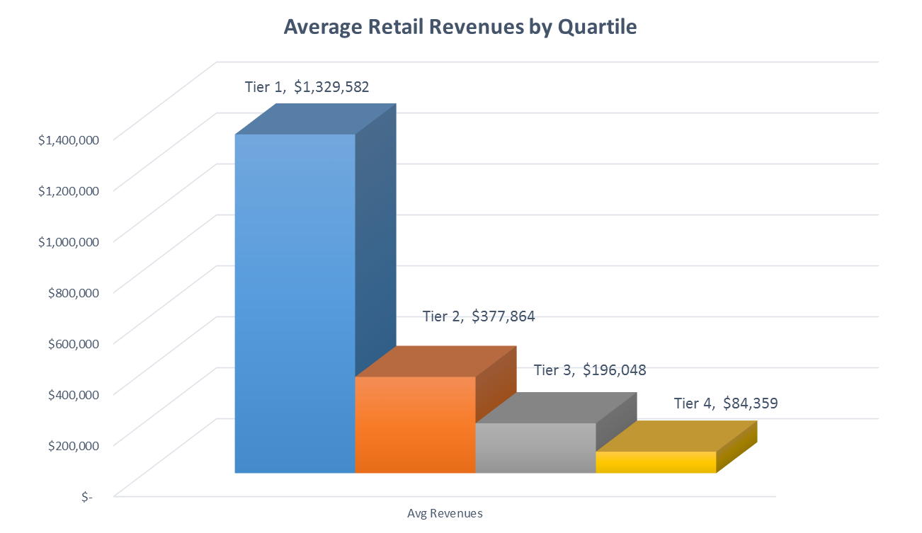
Average Retail Revenues by Tier
Average Revenue of all gTLDs $500,789
Notes:
If we look at revenues by tier, you can clearly see the jump between a tier 1 and a tier 2 with a tier 1 having over 3 times the amount of revenue.

Slide 31
Pricing
To date, the new gTLDs with the highest volumes and values have not improvised by being cheaper.
Tiers | Average Retail Price | Median Price
1 | $ 65.76 | $ 39.50
2 | $ 41.26 | $ 34.50
3 | $ 74.86 | $ 39.50
4 | $ 32.65 | $ 44.50
Notes:
Pricing by tier is shown with the average and median prices in Q1.

Slide 32
Is there a Correlation between Price & Volume?
Period | Correlation | Significance
Q1 2015 – Overall | -0.09 | No or Negligible relationship
Q1 2015 – Tier 1 | -0.24 | Weak negative relationship
Q1 2015 – Tier 2 | -0.51 | Strong negative relationship
Q1 2015 – Tier 3 | -0.12 | No or negligible relationship
Q1 2015 – Tier 4 | -0.28 | Weak negative relationship
Q4 2014 - Overall | -0.23 | Weak negative relationship
Notes:
The question keeps arising on pricing and volume. Here we see there is a strong negative relationship in Tier 2 which suggests that a TLD in this tier may be able to increase their volume by decreasing their price. The current average of a tier 2 domains name is $41.26.

Slide 33
Financial Implications: Tier 1 Today
Volume: | 48,384
Reg. Retail Price: | $39.50
Expenses: | $300,000
Renewal Rate: | 60%
The price and volume is unique to its own tier along with the associated projected expenses
Notes:
Snapshot views of each of the tiers based on the data provided earlier with the actual volume and retail prices. Renewal rates of 60% are standard across all four tiers and expenses in Tier 1 are conservatively estimated at $300k. This shows the revenues, gross margin and cumulative NI over a 5 year period.

Slide 34
Financial Implications: Tier 2 Today
Volume: | 11,240
Reg. Retail Price: | $24.80
Expenses: | $275,000
Renewal Rate: | 60%
Notes:
Tier 2 Expenses est at $275k – please note the reduction in retail prices compared to tier 1 at $39.50

Slide 35
Financial Implications: Tier 3 Today
Volume: | 5,750
Reg. Retail Price: | $44.90
Expenses: | $250,000
Renewal Rate: | 60%
Note the difference in the retail price compared to Tier 2 - $24.80
Notes:
Tier 3 Expenses est at $250k – note the jump in the retail price to $44.90 (up from $24.80 in tier 2

Slide 36
Financial Implications: Tier 4 Today
Volume: | 2,528
Reg. Retail Price: | $19.60
Expenses: | $200,000
Renewal Rate: | 60%
Note the difference in the retail price compared to Tier 3 - $44.90
Notes:
Finally, in tier 4 we have expenses est at $200k – again, note the change in the retail price to $19.60

Slide 37
Quarterly Review Schedule
Event | When & Where
2015 – Q2 | July, Podcast
2015 – Q3 | October, Podcast
2015 – Q4 & 2015 Year in Review
Notes:
So that’s a wrap up of Q1 gTLD report. Future podcasts are schedules.

Slide 38
Contact Us
Channel | Address
Email | info@dottba.com
Twitter | @dottba
Site | http://dottba.com
Channel | Address
Email | info@virtualroot.com
Twitter | @tldwatch
Site | https://tldwatch.com
Notes:
Thank-you for listening, if you have any questions feel free to contact either of us.

